Slide 1
RAKSHAK
(Flow check and control using-Piezoelectric Pressure Sensor-pad,Advance software)
Guided By:
Dr.Pooja Mishra MAM.
Presented By:
1. Akul Juneja(IEC2017020)
2. Prateek(IEC2017029)

Slide 2
Abstract
In a crowd crush, people are subjected to compressive forces by being pushed from all sides (or against a barrier such as a wall) with nowhere to move into. In a progressive crowd collapse, one person falls, creating a space in the crowd into which others fall, creating an even larger hole.
This majorly occurs in large gatherings in motion like rallies, star events and especially Kumbh Melas.

Slide 3
Previous Casualties
Every three years, more than 30 million Hindu worshippers gather for the Kumbh Mela in India, the world's largest religious gathering, in order to wash away their sins. With massive crowds descending on small cities and towns, stampedes inevitably happen, and in 2003, 39 people were killed during the festival.
Between 2001 and 2014 over 2400 lives have been lost in such kumbh melas in india.
The case of the recent Hajj stampede, a type of barrier was formed by a collision between two groups moving towards each other on the same road.
At religious pilgrimages, stampedes have caused deaths at sporting matches, music events and during emergency situations, such as fires and explosions.

Slide 4
So to solve this huge problem ,
We needed a way to regulate the flow of people
To have fewer stampedes and fewer deaths.

Slide 5

Way to solve.
We wanted to know 3 things-
The no. of people.
The location.
And the rate of flow of people per minute.

Slide 6
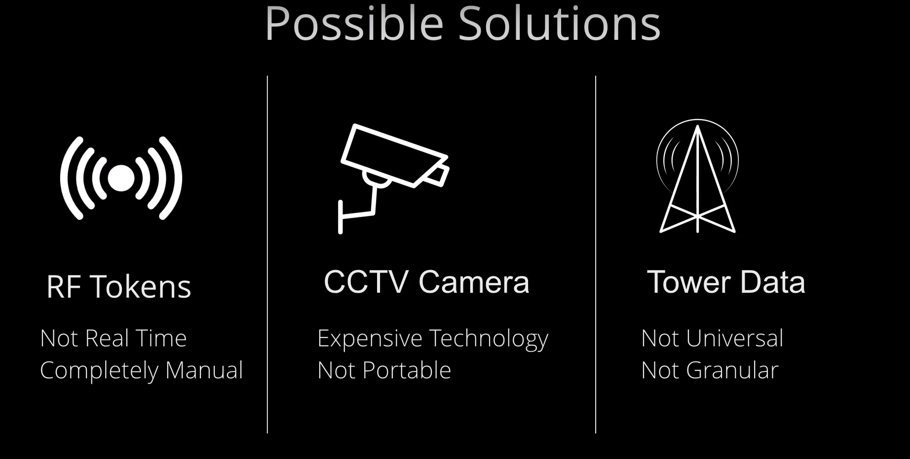
POSSIBLE SOLUTIONS

Slide 7
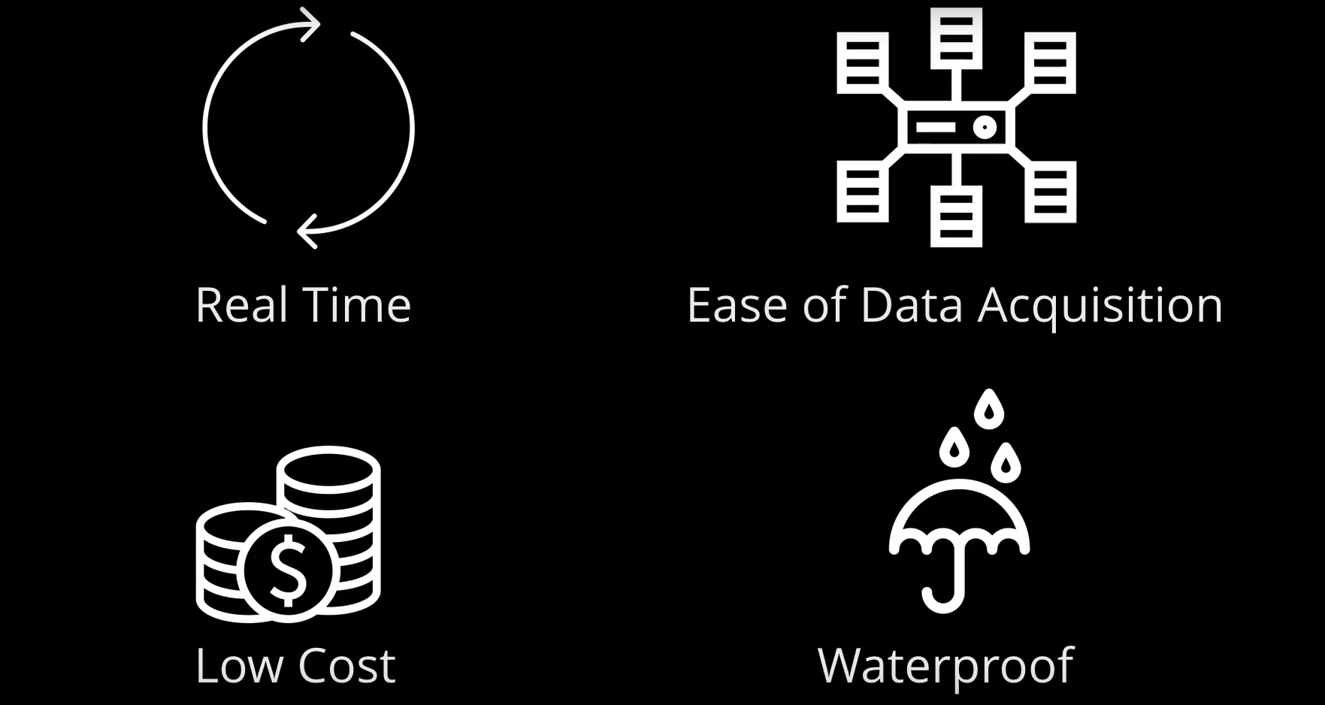
We wanted something

Slide 8
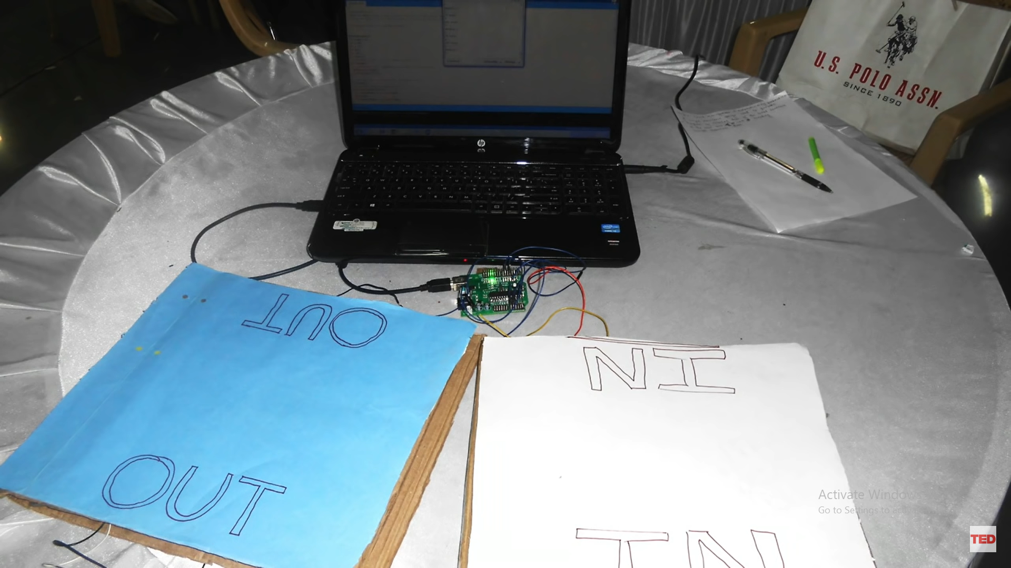
Resulted in creation of our RAKSHAK.

Slide 9

Theory

Slide 10
To create a portable mat which has pressure sensors which can count the no. of people walking on it and sends the data over the internet to the data analysis software we created.
OUR GOAL:

Slide 11
Working Principle:
It Works on Poezoelectric effect.
Piezoelectric Effect is the ability of certain materials to generate an electric charge in response to applied mechanical stress. The word Piezoelectric is derived from the Greek piezein, which means to squeeze or press, and piezo, which is Greek for “push”.

Slide 12
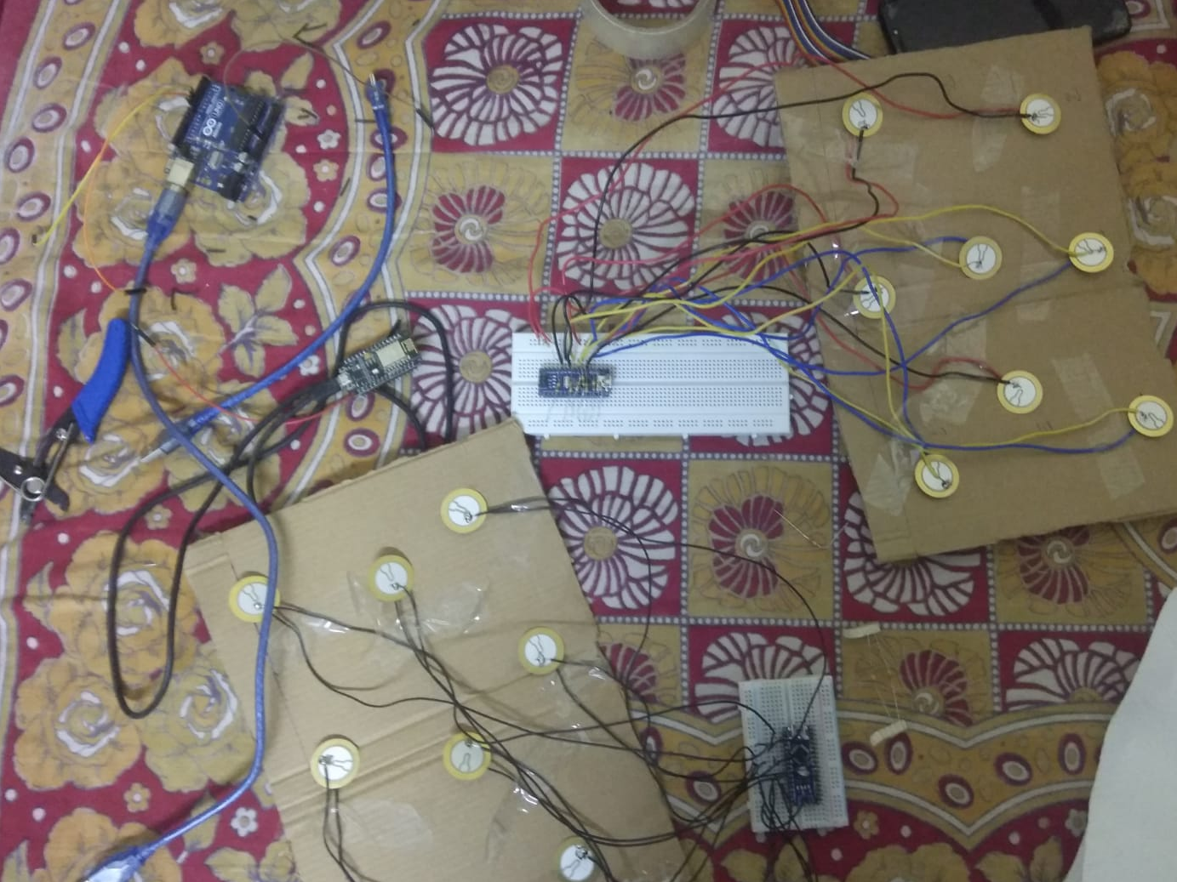
Figure

Slide 13
Analysis of Result

Slide 14
Output
We have calculated the number of people passing through our checkpoint in a minute from in post and out post. Let rate at checkpoint A be Ra and checkpoint B be Rb. if Ra ~= Rb +- 200 there is not any problem but if deviates from this range there can be a condition of stampede.

Slide 15
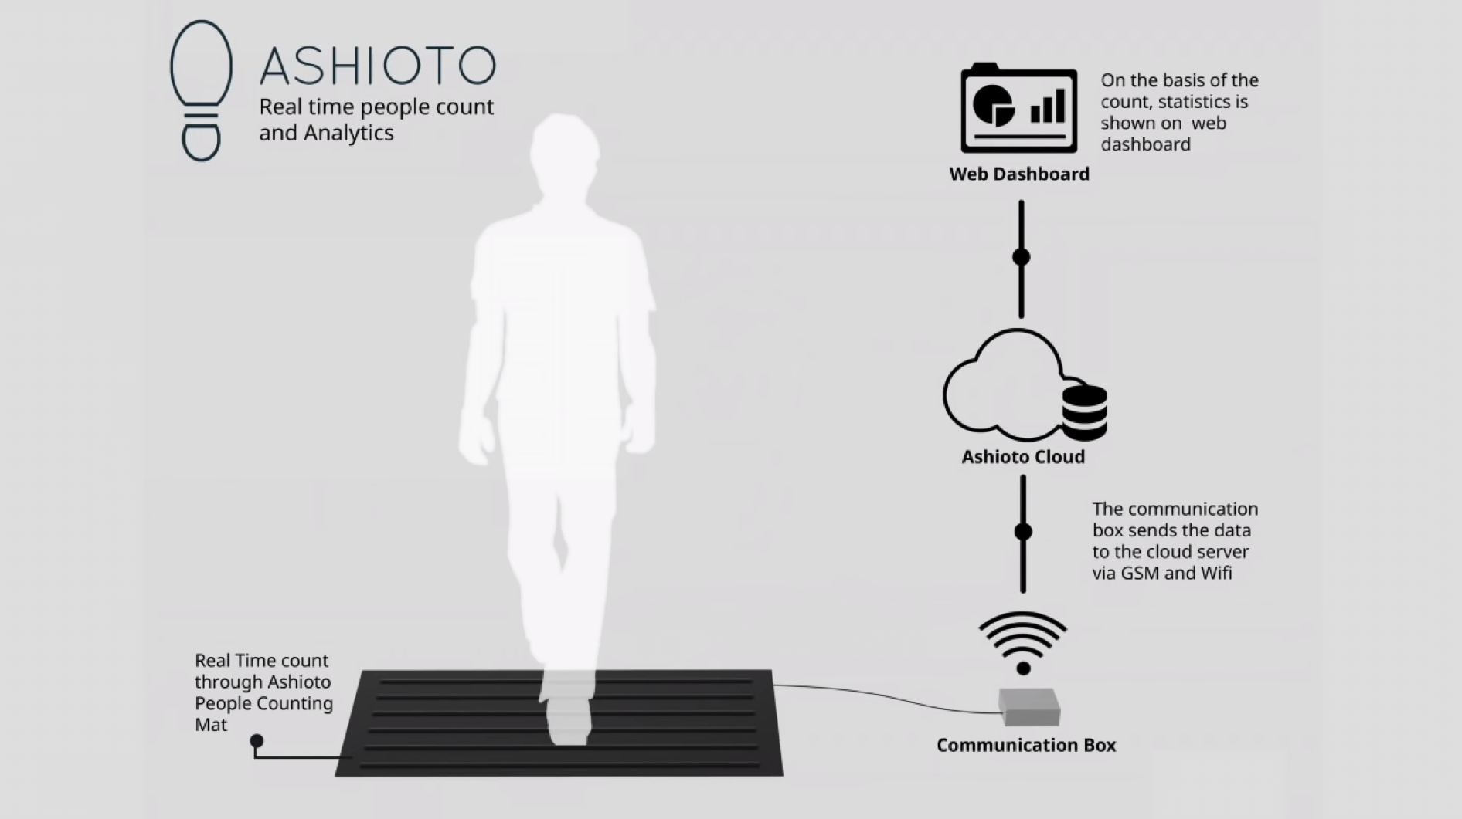
Inspired from -
We got our inspiration to make this from the big life changing invention ASHIOTO.

Slide 16
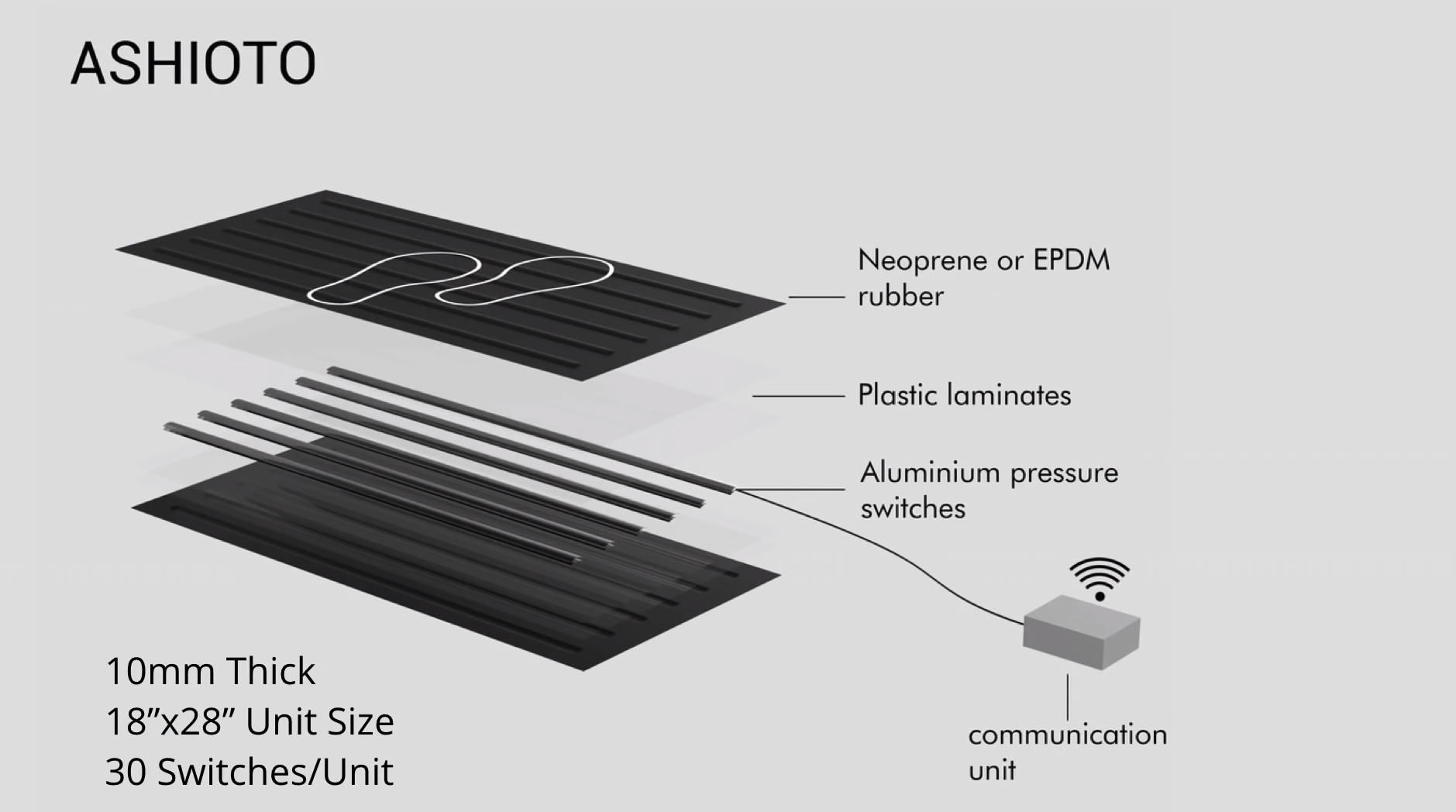

Slide 17
Which not only succeeded in reducing the stampedes and their intensity, but also marked 2015 as the first Nashik Kumbh Mela to have zero stampedes.
It was the first time in recorded history that this event passed without any casualties.

Slide 18
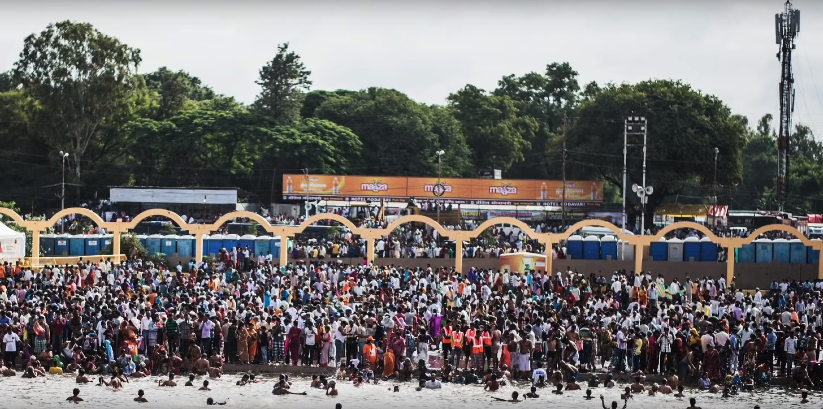

Slide 19

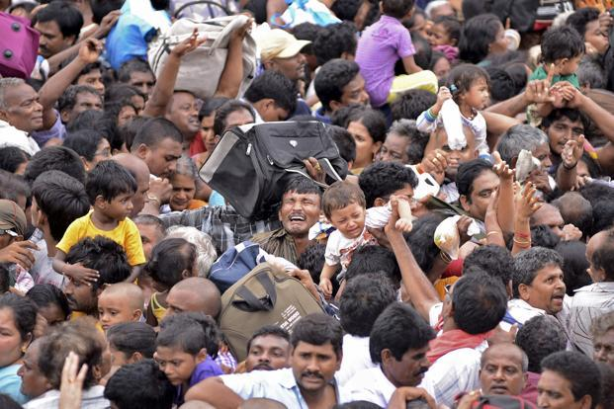
A picture is worth a thousand words

Slide 20
Thanks!

